Slide 1
OPERATING LEASE
Business Process in DSF
Presentate by Marion Jane
http://www.free-powerpoint-templates-design.com

Slide 2
Process in OLSS
BAST – Berita Acara Serah Terima
Billing Process
Monitoring Schedule Billing
Maintenance
Monitoring Asset
Monitoring STNK, KEUR & Insurance
Asset Selling

Slide 3
Process in OLSS
BAST – Berita Acara Serah Terima
Billing Process
Monitoring Schedule Billing
Maintenance
Monitoring Asset
Monitoring STNK, KEUR & Insurance
Asset Selling

Slide 4
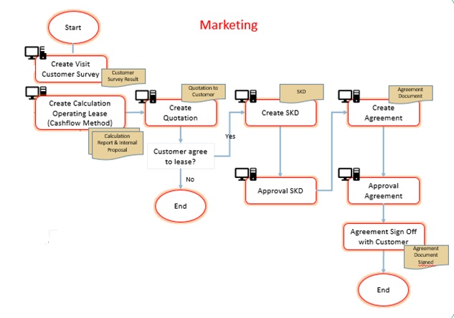
BAST

Slide 5
Calculation
Step 1:
Basic Information Product & Basic Information Lease
Step 2: Cost Condition
→ Product Price, Accessories, Carroserrie, RV
Step 3: Maintenance Condition
→ Full Maintenance, Customer Service Desk,
Non Maintenance
Step 4: Insurance Condition
→ Gross Premium, Commision Amount, Net Premium
Step 5: ROA (Return Of Asset)
Step 6: PIC Information

Slide 6
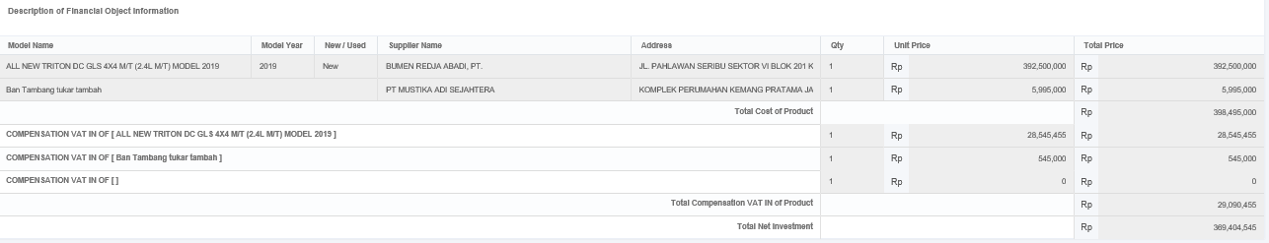
SKD (Surat Keputusan Direksi)
Quantity Lease
Net Investment

Slide 7
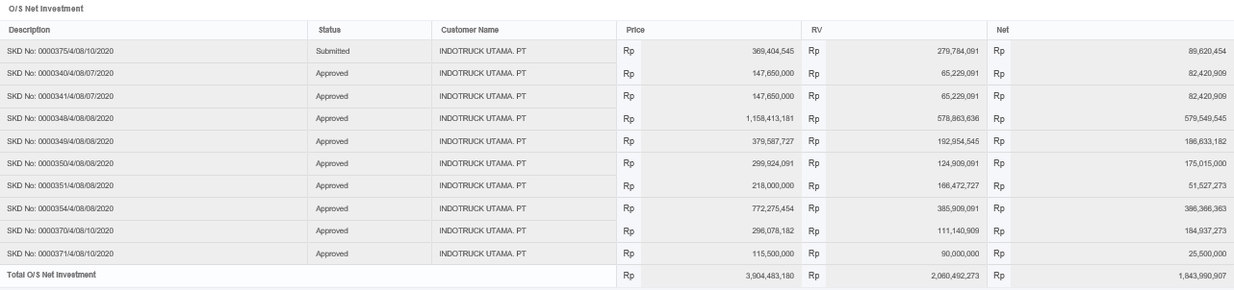
SKD (Surat Keputusan Direksi)
Outstanding NI

Slide 8
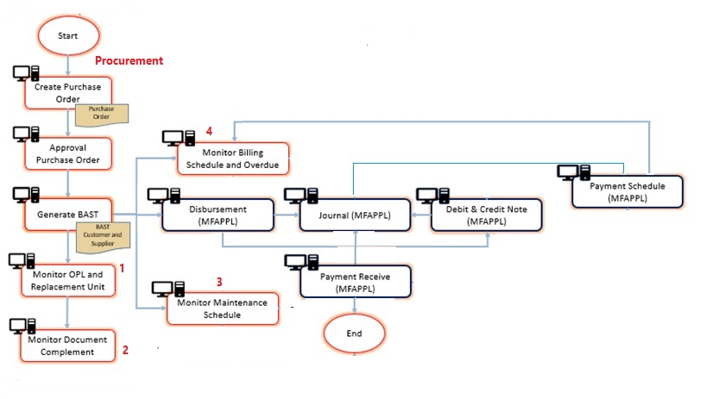
BAST (cont.)

Slide 9
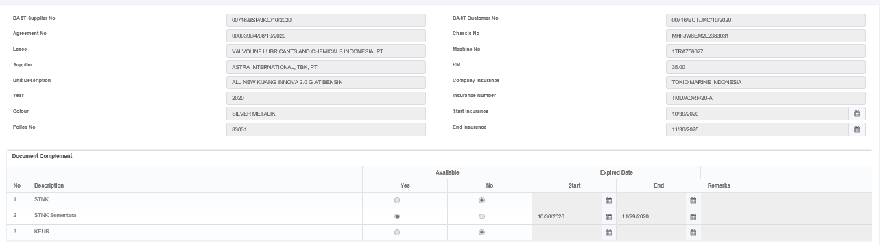
BAST

Slide 10
Process in OLSS
BAST – Berita Acara Serah Terima
Billing Process
Monitoring Schedule Billing
Maintenance
Monitoring Asset
Monitoring STNK, KEUR & Insurance
Asset Selling

Slide 11
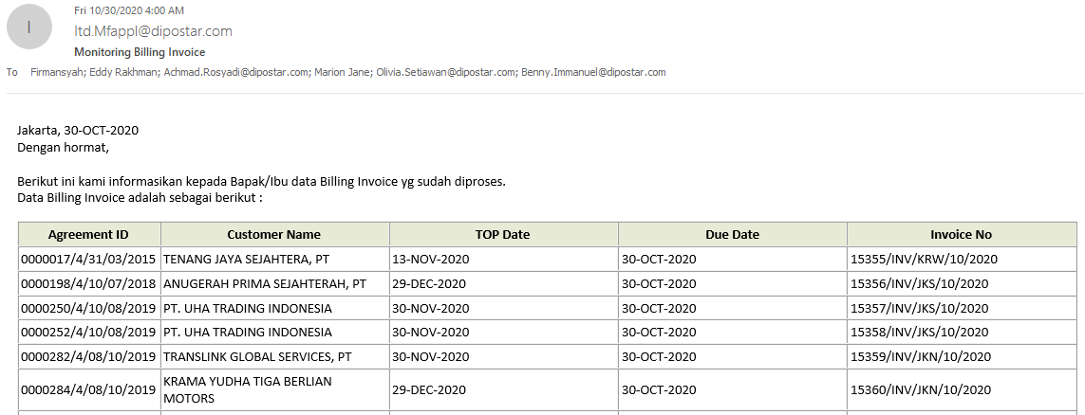
Billing Process

Slide 12
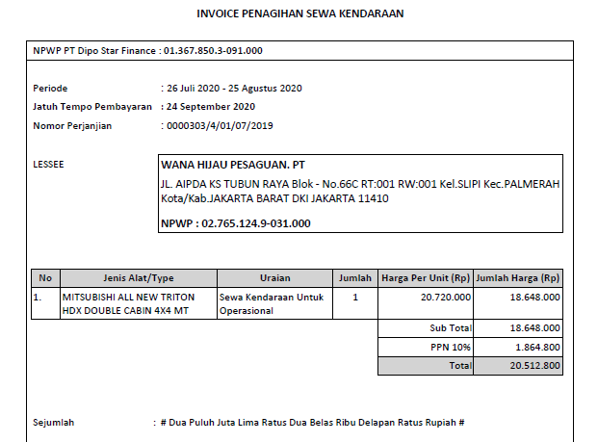
Billing Process (Cont.)

Slide 13
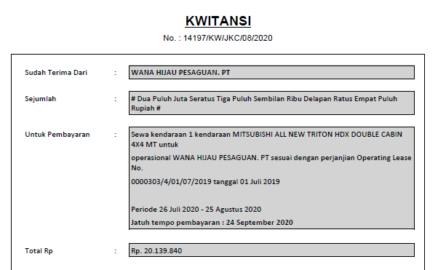
Billing Process (Cont.)

Slide 14
Process in OLSS
BAST – Berita Acara Serah Terima
Billing Process
Monitoring Schedule Billing
Maintenance
Monitoring Asset
Monitoring STNK, KEUR & Insurance
Asset Selling

Slide 15
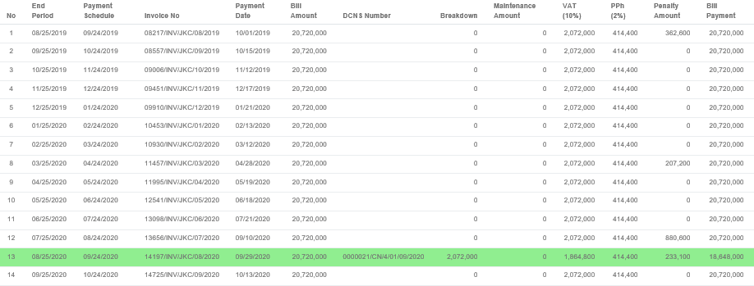
Monitoring Schedule Billing

Slide 16
Thank you!

